Slide 1
Spring Distributed Services
Knowledge is present everywhere

Slide 2
Remote Service Definition
Remote services are services hosted on remote servers
Accessed by clients over the network.
Spring features integration classes for remoting support using various technologies.
The remoting support eases the development of remote-enabled services, implemented by your usual (Spring) POJOs.
Spring Remoting exposes services over the web for Spring clients to consume as easily as though they were locally instantiated.

Slide 3
Remoting Technologies
RMI- Remote Method Invocation - Use RMI to invoke a remote method. The java objects are serialized. RMI also has firewall issues.
Hessian- Transfer binary data between the client and the server.
Burlap- Transfer XML data between the client and the server. It is the XML
alternative to Hessian.
Hessian and Burlap are portable; integrate with other languages
such as C# and PHP
Spring’s HTTP invoker- Spring provides a special remoting strategy which allows
for Java serialization via HTTP, supporting any Java interface .
Both client and server applications have to be based on Spring.
JMS- Remoting using JMS is supported via the
JmsInvokerServiceExporter and JmsInvokerProxyFactoryBean classes.
AMQP- Remoting using AMQP as underlying protocol - supported by the Spring
AMQP project.
JAX-WS. Spring provides remoting support for web services via JAX-WS [SOAP]

Slide 4
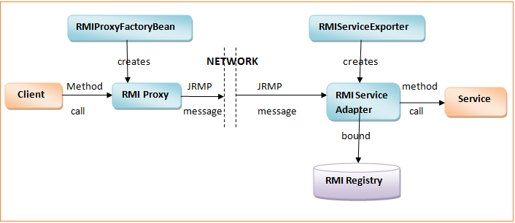
RMI, Http, Hessian & Burlap
HessianProxyFactoryBean
HessianServiceExporter
HttpProxyFactoryBean
BurlapProxyFactoryBean
HttpInvokerServiceExporter
BurlapServiceExporter
Http Proxy
Hessian Service Adapter
Hessian Proxy
Http Service Adapter
Burlap Proxy
Burlap Service Adapter
Web Server
Notes:
Hessian binary data transfer - client uses HTTP protocol to invoke remote methods on the server.
Burlap XML data transfer - client uses HTTP protocol to invoke remote methods on the server.
HTTP standard Java serialization mechanism to expose services through HTTP

Slide 5
Configure HTTP Server/Client
SERVER
@Bean(name = "/weather")
public HttpInvokerServiceExporter exporter() {
HttpInvokerServiceExporter exporter=new HttpInvokerServiceExporter();
exporter.setService(weatherService());
exporter.setServiceInterface(WeatherService.class);
return exporter;
}
CLIENT
@Bean
public HttpInvokerProxyFactoryBean weatherService() {
HttpInvokerProxyFactoryBean factory =
new HttpInvokerProxyFactoryBean();
factory.setServiceUrl("http://localhost:8080/HTTPInvokerServer/weather");
factory.setServiceInterface(WeatherService.class);
return factory;
}
WeatherService…proxy interface

Slide 6
Configure Hessian Server/Client
SERVER
@Bean(name = "/weather")
public HessianServiceExporter exporter() {
HessianServiceExporter exporter = new HessianServiceExporter();
exporter.setService(weatherService());
exporter.setServiceInterface(WeatherService.class);
return exporter;
}
CLIENT
@Bean
public HessianProxyFactoryBean weatherService() {
HessianProxyFactoryBean factory = new HessianProxyFactoryBean();
factory.setServiceUrl("http://localhost:8080/HessianServer/weather");
factory.setServiceInterface(WeatherService.class);
return factory;
}
WeatherService…proxy interface

Slide 7
Main Point
Distribution of work makes possible better organized more specialized and scalable systems.
Science of Consciousness: Pure Consciousness has infinite organizing power.

Slide 8
Service Oriented Architecture(SOA)
Some Definitions
Web Service
Usually single function, e.g., producing data, validating a customer, or providing simple analytical services.
Service-Oriented Architecture
A collection of services.
Sequenced data passing
Multiple services coordinating some activity.
A way of aggregating services to business processes.
Defined by service directories, service governance, Security, SLA,
orchestration…
Orchestration
Provides central control over a business process[ AKA Workflow].
Choreography
Global description of the participating services, a decentralized approach for service composition.
Notes:
BPEL is a standard for orchestration, for which development tools and engines are available

Slide 9
Services Oriented Architecture
Publish & Lookup
Service Directory
UDDI
Services
Locate
Publish
WSDL
Service Consumer
Service Producer
Access

Slide 10
SOA Orchestration
Web Service
Central control over a business process
Process flow between services is controlled by a single service
Web Service
Web Service
… Process Flow …

Slide 11
SOA Choreography
Describes the interactions between multiple services, where no one service "owns" the conversation.
Web Service
Collaboration
Web Service
Web Service

Slide 12
Simple Object Access Protocol
SOAP
Language, platform, and transport independent
(not only HTTP)
Works well in distributed enterprise environments
Standardized
Built-in error handling
Provided document style to better represent domain model
Strong enterprise adoption – B2B
Built-in Security
Business Process Language {BPEL}

Slide 13
Web Services Description Language for SOAP
XML format for describing network services as a set of endpoints operating on messages containing either document-oriented or procedure-oriented information.
Procedure-oriented : RPC Style
Defines that the SOAP message body is viewed as a single structure consisting of a method name and a set of parameters.
Document-oriented: Document Style
Defines of data/information [ Domain Object] payload .vs. RPC.
The operations and messages are described abstractly, and then bound to a concrete network protocol and message format to define an endpoint

Slide 14
Web Service Generation
Contract-first web service
The "contract" (a WSDL definition[XML] of operations and endpoints and XML schema of the messages) is created first, without actually writing any service code.
Contract-last web service
Existing logic is "exposed" as a web service and the contract is Generated from it.
Spring WS
“Features …a solution for contract-first, document-driven web services
- highly recommended for building modern, future-proof web services.”
  Generate WSDL from an XML schema definition [Domain Model]
Generate Java classes from the WSDL XML schema definition

Slide 15
Artifacts to “Manually” Construct
Create the SOAP XML Schema definitions:
AccountDetails.xsd ---------------------------------- Domain Model Schema
AccountDetailsServiceOperations.xsd --------- Request/response schema
Build using eclipse→ run as→ Maven Build [ goal: clean install]
Create SOAP Implementation Classes
AccountService.java ---------------------------------- Service Interface
AccountServiceImpl.java ----------------------------- @Service access “dao”
AccountServiceEndPoint.java ----------------------- Handles Request
Eclipse run as→ Run on Server
Click on URL on displayed Web Page : [Generate WSDL ]

Slide 16
Domain Model Schema
<xs:element name="Account" type="Account"/>
<xs:complexType name="Account">
<xs:sequence>
<xs:element name="AccountNumber" type="xs:string"/>
<xs:element name="AccountName" type="xs:string"/>
<xs:element name="AccountBalance" type="xs:double"/>
<xs:element name="AccountStatus" type="EnumAccountStatus"/>
</xs:sequence>
</xs:complexType>
<xs:simpleType name="EnumAccountStatus">
<xs:restriction base="xs:string">
<xs:enumeration value="Active"/>
<xs:enumeration value="Inactive"/>
</xs:restriction>
</xs:simpleType>

Slide 17
Generate Domain Classes
Based on XML schema
The right approach is do this automatically during build time using a maven plugin
<plugin>
<groupId>org.codehaus.mojo</groupId>
<artifactId>jaxb2-maven-plugin</artifactId>
…
<goals>
<goal>xjc</goal>
</goals>
…
</plugin>
JAXB simplifies access to an XML document from a Java program - binds the schema for XML document to set of Java classes that represents the schema.
XJC binding compiler from the JAXB distribution

Slide 18
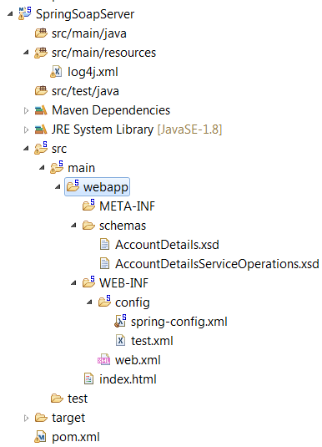
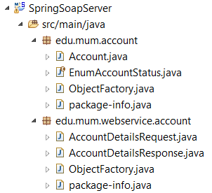
Soap Server Project
Before Maven Build After Maven Build

Slide 19
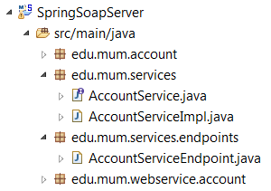
Create SOAP Implementation Classes
Server side Implemented Classes to utilize SOAP Service
AccountService; AccountServiceImpl:
Reflect Spring @Service
AccountServiceEndpoint:
Processes SOAP Request/Response Operations/Payloads

Slide 20
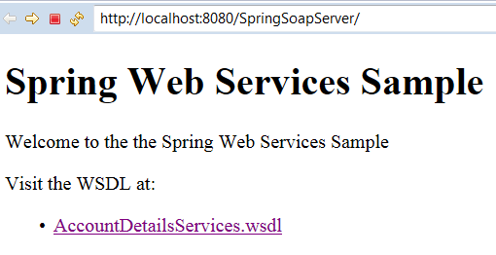
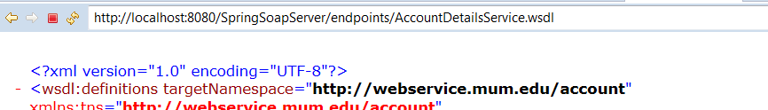
SOAP Server - WSDL
Run As -> Run on Server

Slide 21


SOAP Client
Generate Java classes from the WSDL XML schema definition
The right approach is do this automatically during build time using a maven plugin
Import WSDL :
eclipse -> import->web service->Launch Web Services Explorer
[upper right ] select WSDL page
Click WSDL main – right panel enter WSDL URL
[upper right ] select download
Target: Workbench project : SoapClient
Notes:
Click on URL in right[left] panel to see download??

Slide 22
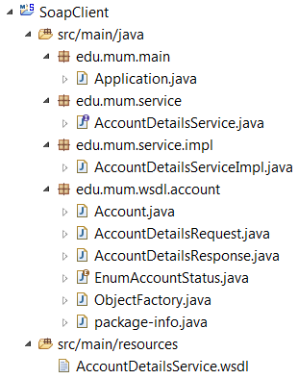
Client Classes Generated from WSDL
Auto-generated by maven clean install based on WSDL
AccountDetailsService.java
AccountDetailsServiceImpl.java
Spring @Service…
Communicates with SOAP Server via
Spring WebServiceTemplate
Run as Application – edu.mum.main.Application.java

Slide 23
Main Point
SOAP is characterized by standards and tools based on those standards that automatically generate Client-Server connectivity.
The Laws of Nature are conventions [or standards] that spontaneous supports the underlying structure that provides continuity to Life.

Slide 24
Messaging Systems
[JMS & AMQP]
Loosely coupled - asynchronous - reliable –
communication between applications
Performance
improved response times by doing some tasks asynchronously
Decoupling
Reduced complexity by decoupling and isolating applications
Scalability
Scale distribute tasks across machines based on load
High-quality, cost-effective
Build apps based on specific function - easier to develop, debug, test
High availability
Robustness and reliability- message queue persistence -
potential zero-downtime redeploys

Slide 25
JMS & AMQP
JMS has queues and topics.
A message sent on a queue is consumed by no more than one client.
A message sent on a topic may be consumed by multiple consumers.
AMQP only has queues….and exchanges
Queues are only consumed by a single receiver
AMQP doesn’t publish directly to queues.
A message is published to an exchange
routed to one queue or multiple queues
Emulating [JMS] queues and topics.
Notes:
Queues are only consumed by a single receiver
If more than one consumer subscribes to the same queue, the messages are dispensed in a round-robin fashion.
OSI levels
JMS Messaging protocol
application and session protocols (OSI notation) or application level transports
AMQP wire Protocol
A low-level interface. It typically refers to programming interfaces (APIs) in a network directly above the physical layer that are used strictly for transport or interconnection.

Slide 26
Java Messaging Service
A specification[JSR 914] that describes a common way for Java programs to create, send, receive and read distributed enterprise messages
loosely coupled communication
Asynchronous messaging
Reliable delivery
  A message is guaranteed to be delivered once and only once.
Outside the specification
  Security services
  Management services
Notes:
Asynchronous. A JMS provider can deliver messages to a client as they arrive; a client does not have to request messages in order to receive them.
Lower levels of reliability are available for applications that can afford to miss messages or to receive duplicate messages.
The JMS specification describes a set of programming interfaces that support distributed, enterprise messaging. An enterprise messaging systems enables independent distributed components or applications to interact through messages. These components, whether on the same system, the same network, or loosely connected through the Internet, use messaging to pass data and coordinate their respective functions.
exposing only the JMS APIs is to hide the details from the users that want a higher-level API and also to ensure portability among implementations.
As long as the vendor adheres to the JMS specification, a user shouldn't have to worry too much about how the implementation is constructed.
By itself, it provides no functionality: the API or interfaces are separate from the implementation This gives the benefit of describing in detail what the user view should be, while at the same time allowing vendors to implement the details however they want.
JMS is not an implementation of a message-oriented middleware.
security and management are not the concerns of the JMS spec

Slide 27
Terminology
Broker
Responsible for receiving, routing, and dispensing messages to consumers.
Client
Application - uses message broker to communicate with other applications.
Consumer
Application that consumes messages from a messaging destination.
Destination
Holding area for messages in broker. Clients publish/consume from…
Durable Subscriber
Consumer receives all messages published on a topic- even after inactive
Message
An atomic unit of data that is passed between two or more clients.
Producer
Application that creates and posts messages to a messaging destination.
Queue
A destination that uses first in/first out semantics.
Topic
A destination that uses publish and subscribe semantics.
Notes:
https://access.redhat.com/documentation/en-US/Red_Hat_JBoss_Fuse/6.0/html/Glossary/files/FuseMessaging.html
http://localhost:8161/admin/queues.jsp
http://activemq.apache.org/jmstemplate-gotchas.html

Slide 28
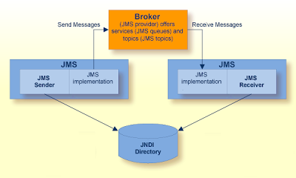
Decoupled Distributed Messaging
[JMS Example]

Slide 29
Main Point
Messaging oriented services guarantee a reliable communication and simplify the complexity of the applications.
Science of Consciousness: Pure Consciousness is simple, reliable, efficient and precise.

Slide 30
JMS Services
Point-to-Point (PTP)
  Built around the concept of a message queue
  Each message has only one consumer
  Multiple producers
Publish-Subscribe systems
  Uses a “topic” to send and receive messages
  Each message has multiple consumers
  Single producer
Notes:
http://activemq.apache.org/jmstemplate-gotchas.html

Slide 31
Point-to-Point
Msg
Msg
consumes
Client1
Client2
Client2
Queue
sends
acknowledges
Multiple Producers Allowed
Single Consumer
Notes:
Alex Su
, Software Developer Slide share 2011

Slide 32


Publish/Subscribe
subscribes
Topic
Client2
Msg
Client1
delivers
publishes
Client3
delivers
Single Producer
Multiple Consumers Allowed

Slide 33
Synchronously
  A subscriber or a receiver explicitly fetches the message from the destination by calling the receive method.
  The receive method can block until a message arrives or can time out if a message does not arrive within a specified time limit.
Asynchronously
  A client can register a message listener with a consumer.
  Whenever a message arrives at the destination, the JMS provider delivers the message by calling the listener's onMessage() method.

Slide 34
Message Types
TextMessage A java.lang.String object
MapMessage A set of name/value pairs
BytesMessage A stream of uninterpreted bytes
StreamMessage A stream of primitive values
ObjectMessage A Serializable object

Slide 35
Demo
Connect to BROKER
<bean id=“connFactory” class=“org.apache...ActiveMQConnectionFactory"
p:brokerURL="tcp://localhost:61616“
Assign Broker Queue -- PTP
<bean id="mumEAQueue" class="org.apache...ActiveMQQueue">
<constructor-arg value="mumEA.queue" />
Create Queue Producer
<bean id="jmsTemplate" class="org...jms.core.JmsTemplate">
name="defaultDestinationName" value="mumEAQueue"/>
Create Queue Consumer
<jms:listener destination="mumEAQueue" ref="ptpMessageListener"
Assign Broker Topic – Pub/Sub
<bean id="mumEATopic" class="org.apache...ActiveMQTopic">
<constructor-arg value="mumEA.topic" />
Create Topic Publisher
<bean id="jmsTopicTemplate" class="org...jms.core.JmsTemplate">
name="defaultDestinationName" value="mumEATopic"/>
Create Topic Subscriber
<jms:listener destination="mumEATopic" ref=“PubSubMessageListener”
Notes:
Spring default message listener container.
It creates a fixed number of JMS Sessions to invoke the listener, * not allowing for dynamic adaptation to runtime demands. Its main * advantage is its low level of complexity and the minimum requirements * on the JMS provider: Not even the ServerSessionPool facility is required.
CONTAINER concurrency: The number of concurrent sessions/consumers to start for each listener.

Slide 36
JMS DEMO
QUEUE
MOM Server
PRODUCER
TOPIC
CONSUMER
ActiveMQ Broker
PRODUCER
PUBLISHER
SUSCRIBER
ASSIGN
CONNECT
ASSIGN
“Multiple” JMS Clients
JMSSolo
Senders
Receivers
SUBCRIBER
Client Server
Client Server
JMSToo
Connect to Broker
Assign Queue/Topic
JMSTopicToo
Notes:
http://activemq.apache.org/how-do-i-create-new-destinations.html
NOT actually created until used
different clients creating different ActiveMQQueue instances will communicate with the same physical queue on a JMS broker if the name is the same.

Slide 37
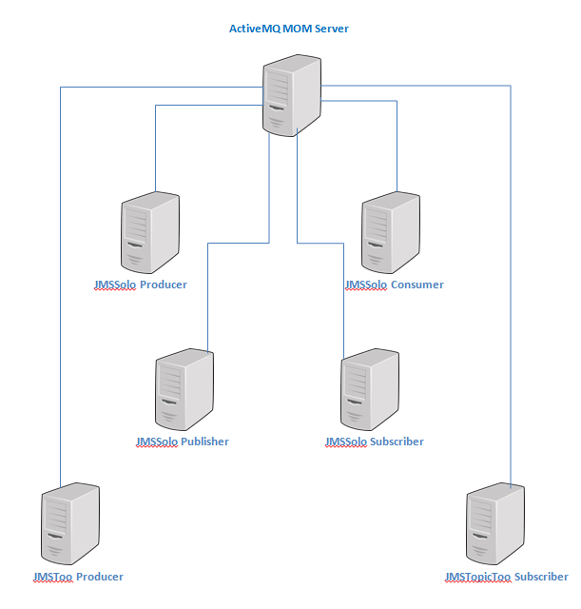
Distributed Server View of JMS Demo

Slide 38

AMQP
(Advanced Message Queuing Protocol )
AMQP is an open protocol standard for Message Oriented Middleware
For queue-related communications between applications
Developed for the financial industry [ JPMorgan – 2006]
AMQP defines a wire-level definition for cross platform interoperability
All AMQP clients can interoperate with all AMQP servers
Diverse programming languages can communicate easily
Legacy message brokers can be retrofitted to remove proprietary
protocols from networks
Enables messaging as a cloud service
PTP & publish-and-subscribe
Transactional messaging functionality
RabbitMQ - THE AMQP
Broker
Notes:
http://www.wmrichards.com/amqp.pdf
http://projects.spring.io/spring-amqp/
wire level protocol
A low-level interface. It typically refers to programming interfaces (APIs) in a network directly above the physical layer that are used strictly for transport or interconnection.
Security
https://www.rabbitmq.com/access-control.html
Simple Authentication and Security Layer (SASL) is a framework for authentication and data security in Internet protocols.
Good article
> In AMQP, queues perform *round-robin* distribution of messages to consumers > (a.k.a subscribers), meaning that only *one* subscriber to a queue will get > each message. (See also Matthew's explanation of acknowledgements.) AMQP's > *exchanges*, on the other hand, perform message *broadcasting*, copying > messages onto all (matching) bound queues.

Slide 39
RabbitMQ [AMQP]
Messaging Service
Queues are “simple” FIFO Queues
Introduces the concept of an Exchange
P
C
QUEUE
P
X
C
QUEUE
P
C
QUEUE
Notes:
guaranteed delivery by choosing the right options(delivery mode = 2 for persistent msgs), and declaring exchanges and queues in advance of running your application so that messages are not discarded.

Slide 40
Producer .vs. Consumer
Centric Queues
Queues are only consumed by a single receiver
Producer Centric queue
If more than one consumer subscribes to the queue, the messages are dispensed in a round-robin fashion.
AKA a work queue
Consumer defined queue[s]
Multiple queues, bound to the same exchange/routing key
Emulate a broadcast message
“A queue per consumer”
See AmqpClient Demo

Slide 41
AMQP Concepts
Exchanges - Message routing agents; accept messages from producers routes to queues
Bindings - binds/maps a queue & exchange
Routing Key - optional attribute to customize binding/routing
Queues - Message placeholders

Slide 42
AMQP Exchanges
Direct - Queue binding requires a direct match based on a “simple” Routing Key. Corresponds to JMS PTP.
NOTE: can have multiple Queues/Consumers
Fanout - Queue is bound directly to exchange no Routing
Key. Corresponds to “basic” JMS Pub/Sub.
Topic - Queue binding requires a direct match based on a “complex” Routing Key [beyond basic JMS Pub/Sub]
Headers - Similar to Topic only uses message headers
instead of explicit Routing Key
Direct & Fanout are identified as MANDATORY by AMQP
Notes:
http://stackoverflow.com/questions/30960153/spring-amqp-project-with-2-queues
Fannout example
Direct exchange
https://www.javacodegeeks.com/2014/10/spring-configuration-rabbitmq-connectivity.html

Slide 43
Topic Demo Use Case
Use Case
A Company’s Order Processing capability need to send orders based on whether the orders are the result of in-store purchases OR online purchases.
Furthermore, online purchases that are for inventory that is
“vintage”[classic] needs special processing.
Solution
Broadcast the Order to the Warehouse using RabbitMQ Topic Exchange. Marking messages as appropriate:
purchases.store.#
purchases.online.#
purchases.online.classic.#

Slide 44
Topic Exchange Routing key
Consists of a list of attributes
Delimited by periods [“.”]
Up to 255 characters in length
Wild cards:
* (asterisk) can substitute for exactly one word.
# (hash) can substitute for zero or more words.
Examples:
<rabbit:binding queue="purchasesStore" pattern="purchases.store.#" />
<rabbit:binding queue="purchasesOnline" pattern="purchases.online.#" />
<rabbit:binding queue=" purchasesOnlineClassic"
pattern="purchases.online.classic.#" />
Routing Key

Slide 45
DEMO - Topic Exchange – Order
<rabbit:queue name="purchasesStore" />
<rabbit:queue name="purchasesOnline" />
<!-- added topic filter to bind only orders that are "classic" -->
<rabbit:queue name="purchasesOnlineClassic" />
purchasesStore
Queue
purchases.store.#
Bind Queue to Exchange
Queue
purchasesOnline
Order
purchases.online.#
purchases.online.classic.#
purchasesOnlineClassic
Queue
<rabbit:topic-exchange name="order">
<rabbit:binding queue="purchasesOnline" pattern="purchases.online.#"
<rabbit:binding queue="purchasesStore" pattern="purchases.store.#"
<rabbit:binding queue="purchasesOnlineClassic“
pattern="purchases.online.classic.#"

Slide 46
Demo Topic Exchange
Topic Producer:
<rabbit:template id="topicTemplate" connection-factory= "connectionFactory“
routing-key="purchases.store“ exchange="order" />
Producer code : OrderServiceImpl.java
public class OrderServiceImpl implements OrderService {
public void publish(RabbitTemplate rabbitTemplate) {
rabbitTemplate.convertAndSend("purchases.online.classic",order)
rabbitTemplate.convertAndSend("purchases.store",order);
rabbitTemplate.convertAndSend("purchases.online",order);
Topic Consumer Example:
<rabbit:listener ref="orderListener" method="listen"
queue-names="purchasesOnlineClassic" />
<bean id="orderListener" class="edu.mum.amqp.OrderListener" />
Consumer code : OrderListener.java
public class OrderListener {
public void listen(Order order) {

Slide 47
DEMO - Direct Exchange
<rabbit:queue name=“directQueue" />
<rabbit:queue name=“answerQueue" />
Direct
Queue
Exchange
order.key
Direct
order.answer
Answer
Queue
<rabbit:direct-exchange name=“direct">
<rabbit:binding queue=“directQueue" key=“order.key”
<rabbit:binding queue=“answerQueue" key=“order.answer”

Slide 48
Demo Direct Exchange
Direct Producer:
<rabbit:template id=“directTemplate" connection-factory= "connectionFactory“
routing-key=“order.key“ exchange=“direct" />
Producer code : DirectServiceImpl.java
public class DirectServiceImpl implements OrderService {
public void publish(RabbitTemplate rabbitTemplate) {
rabbitTemplate.convertAndSend(orderItem)
Direct Consumer Example:
<rabbit:listener ref=“queueListener" method="listen"
queue-names=“directQueue" />
<bean id=“queueListener" class="edu.mum.amqp.DirectListener" />
Consumer code : DirectListener.java
public class DirectListener {
public void listen(Order order) {

Slide 49
DEMO – invoking the Producers
public static void main(String[] args) {
// Publish to Topic
RabbitTemplate topicTemplate =
context.getBean("topicTemplate",RabbitTemplate.class);
OrderService orderService = new OrderServiceImpl();
orderService.publish(topicTemplate);
// Publish to "direct" exchange on order.key == directQueue
RabbitTemplate directTemplate =
context.getBean(“directTemplate",RabbitTemplate.class);
OrderService directService = new DirectServiceImpl();
directService.publish(directTemplate);

Slide 50
AMQP DEMO
MOM Server
answerQUEUE
purchasesOnline
purchasesOnline CONSUMER
Direct
Topic
purchasesOnline classic
PurchasesStore
CONSUMER
purchasesStore
Order.key
PRODUCER
Purchases.store
PRODUCER
directQUEUE
Purchases.online
PRODUCER
directQueueCONSUMER
answerQueue CONSUMER
RabbitMQ Broker
Answer.key
PRODUCER
CONNECT
“Multiple” AMQP Clients
AMQP
Producers
Consumers
Client Server
Connect to Broker
Listen on answerQueue
Listen on purchasesOnline
AmqpClient
Notes:
https://derickbailey.com/2015/09/02/rabbitmq-best-practices-for-designing-exchanges-queues-and-bindings/
Dynmic creation by consumer referred to

Slide 51
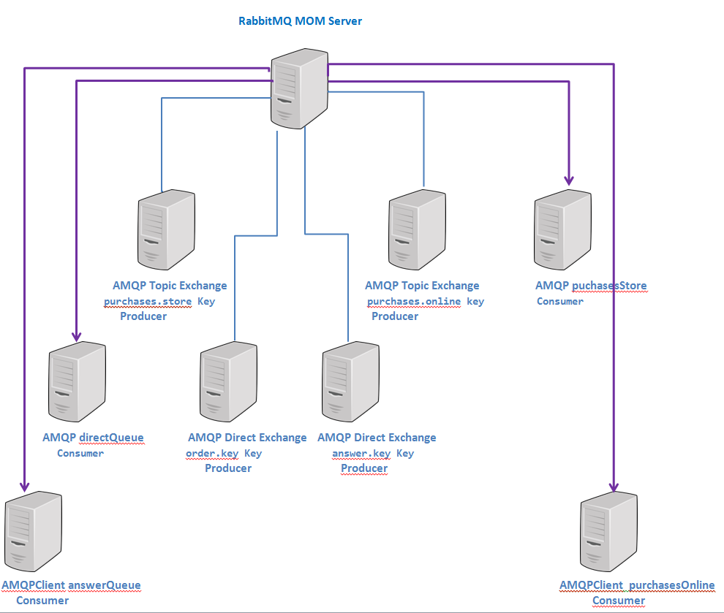
Distributed Server View of AMQP Demo

Slide 52
Main Point
AMQP integrates heterogeneous systems through the introduction of a basic wire protocol.
Science of Consciousness: Acting from the level of Transcendental Consciousness, thoughts and actions are more integrated and harmonious

